Slide 1
ARCH A4988
Coding for
Spatial Practices
Project 03: Catalog Ideas

Slide 2
Celeste Layne

Slide 3
Theme 1 – Staged Photography aka “tableau photographs”
Staging gives the photographer the opportunity to make very specific and careful choices, in order to control every element and even sometimes to give the appearance of spontaneity.
Having created my own staged photography, I am acutely aware of what goes into creating a scene indoors and on location, muchless creating scenes with complex lighting as Gregory Crewdsen and my personal favorite, Ryan Scheude’s complex compositions.
With this collection I’d like to filter photographs created by gender; photographs depicting interior scenes vs exterior scenes; and possibly sort by year.
Notes:
https://www.widewalls.ch/magazine/staged-photography
https://lithub.com/on-fantasy-narrative-and-playing-dress-up-for-the-camera/

Slide 4
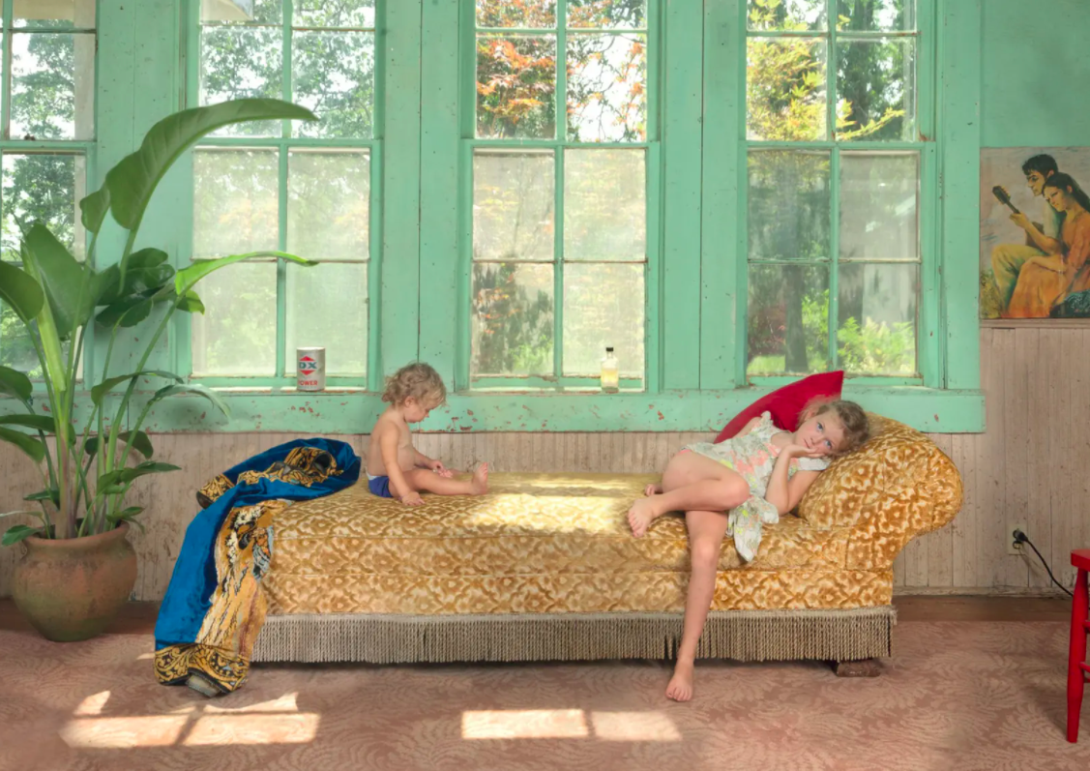
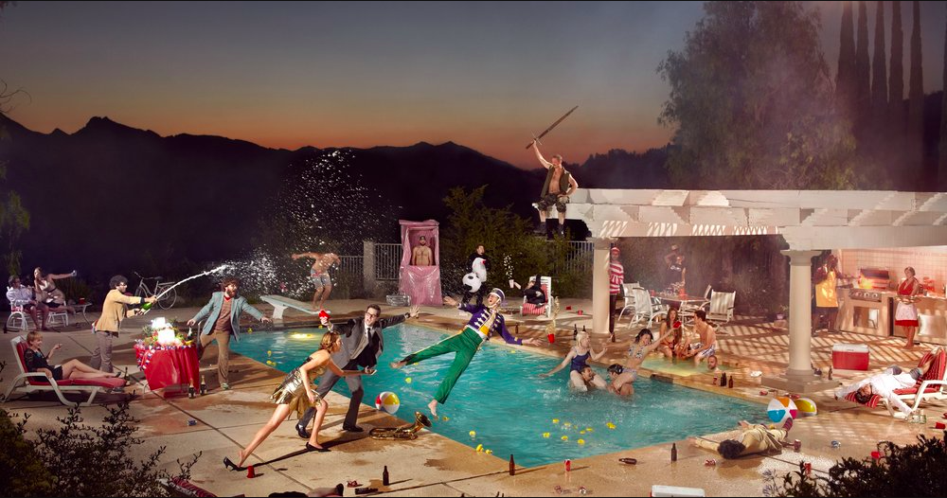
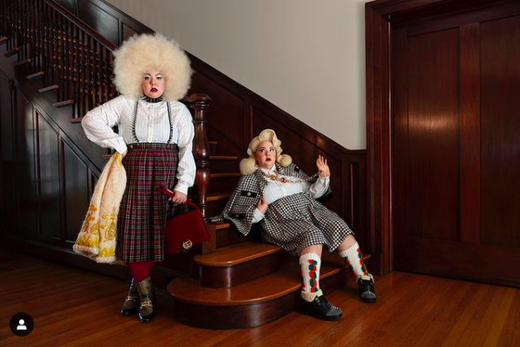
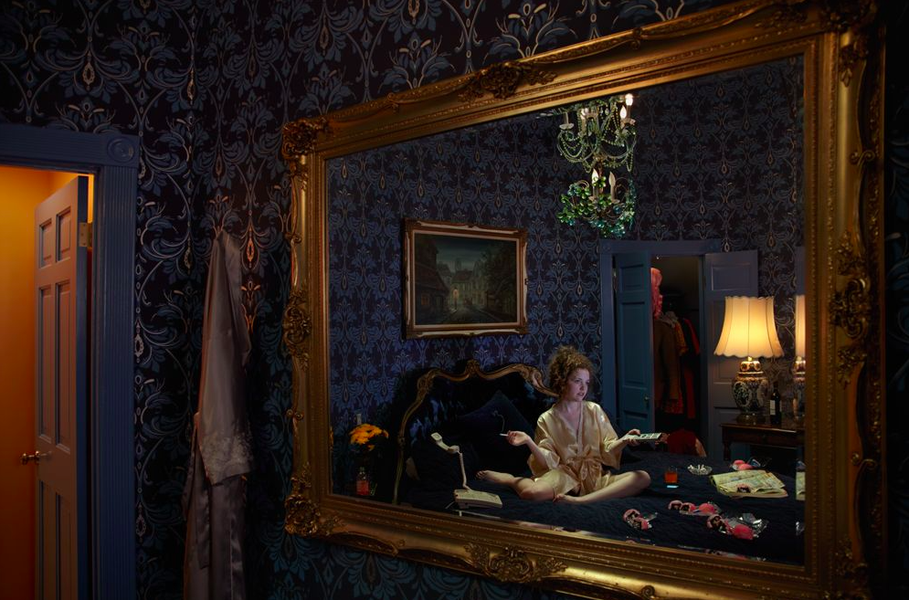
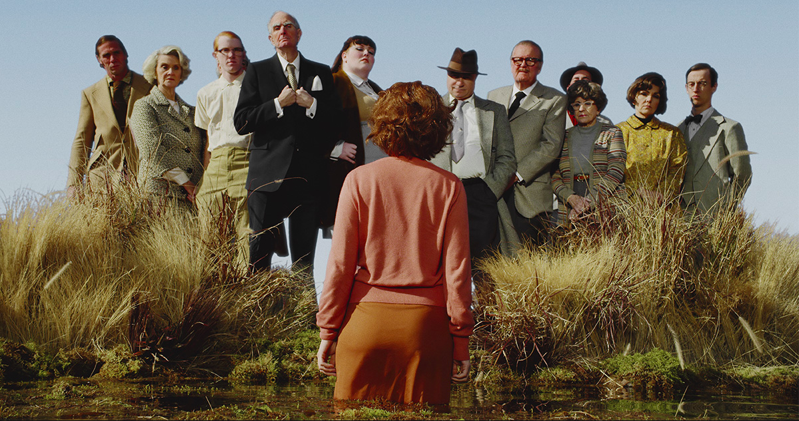
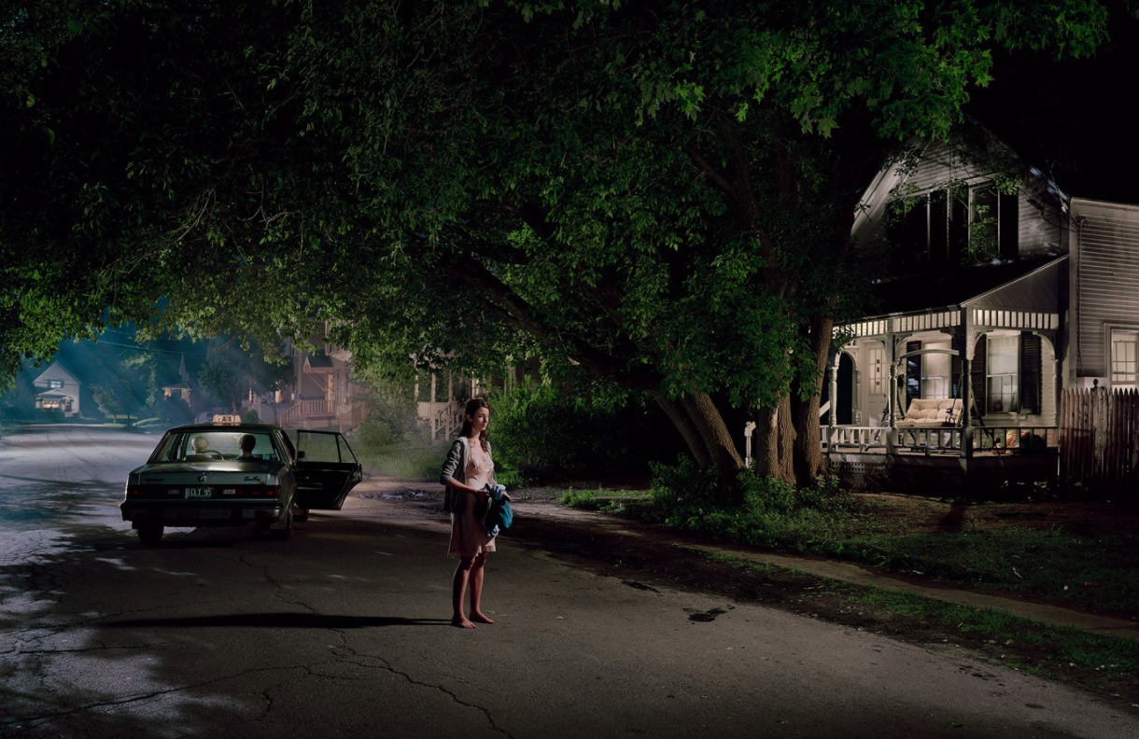
Theme 1 – five (5) examples
Notes:
Gregory Crewdson
Cindy Sherman
Ryan Schude
Genevieve Gaignard
Alex Prager
Julie Blackmon
=====
https://magazine.artland.com/staged-photography-top-ten/

Slide 5
Theme 2 – Symmetry and Color in Film
Wes Anderson's visuals and signature styles have become recognizable and well-studied within the film community. One of his signature techniques that makes his films unique is the use of symmetry. He has consistently and precisely used symmetry in all his shots, visuals, and works that he has produced.
Another signature technique is the use of color – both palettes and filters. He is known for his color palettes that can naturally, creatively, and accurately depict scenes. He also stylistically filters color to bring out the set.
With this collection I can investigate the color and symmetry of the images over time; filter out images with and without people; or sort by color.
Notes:
Wes Anderson has directed 13 movies so I can hopefully find at least 10 stills that meet the criteria per movie.
If I’m unable to find 100 pieces of media for Wes Anderson, maybe I can include Stanley Kubrick and other filmmakers with a similar oeuvre.

Slide 6
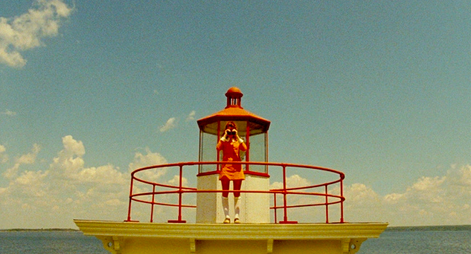
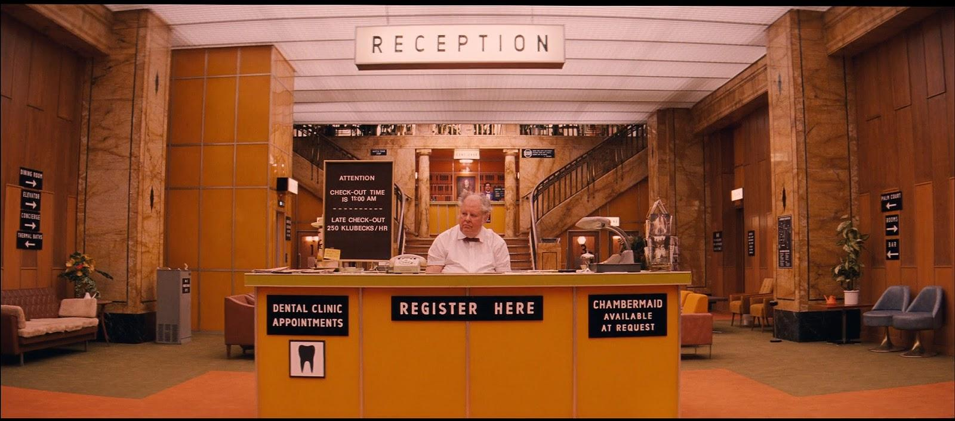
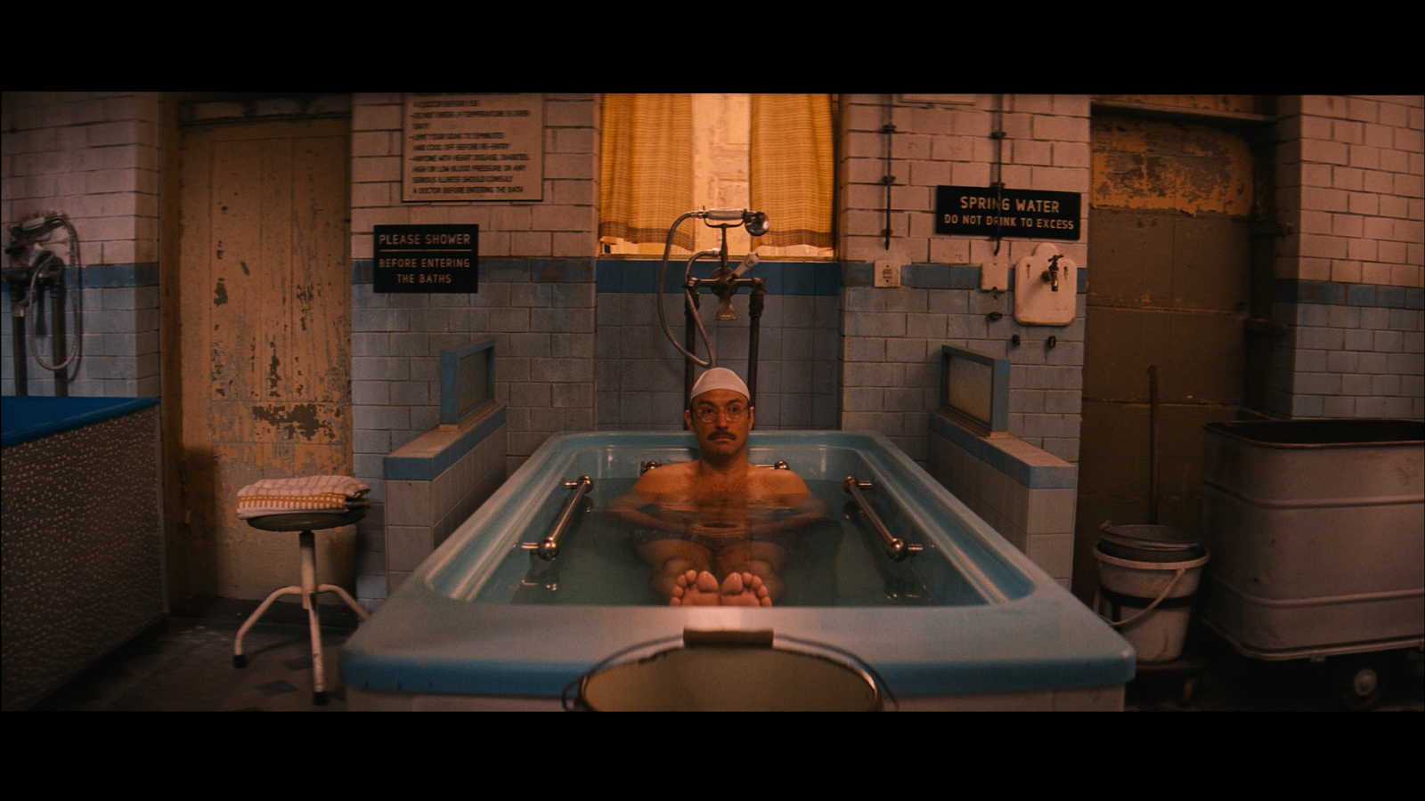
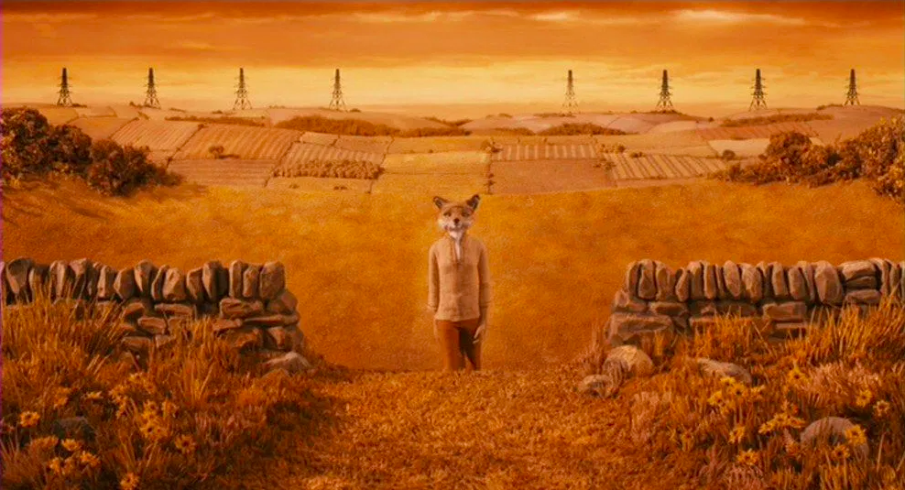
Theme 2 – five (5) examples

Slide 7
Theme 3 – Fashion Show Production
I’m always interested in architects who have applied their architecture backgrounds to alternative paths. Most notable to me are the Rem Koolhaas and AMO designs for Prada. In addition, fashion shows can be quite opulent like Chanel or avante-garde like Virgil Abloh.
Fashion shows are a form of cultural production and as architecture, takes its references from experimentation vs program.
With this collection I can investigate the imagery of each fashion designer/house over time; search for shows designed by architects; filter by season or year. I’d be curious to see if I can get at any location data for the shows.
Notes:
The program is the runway.

Slide 8
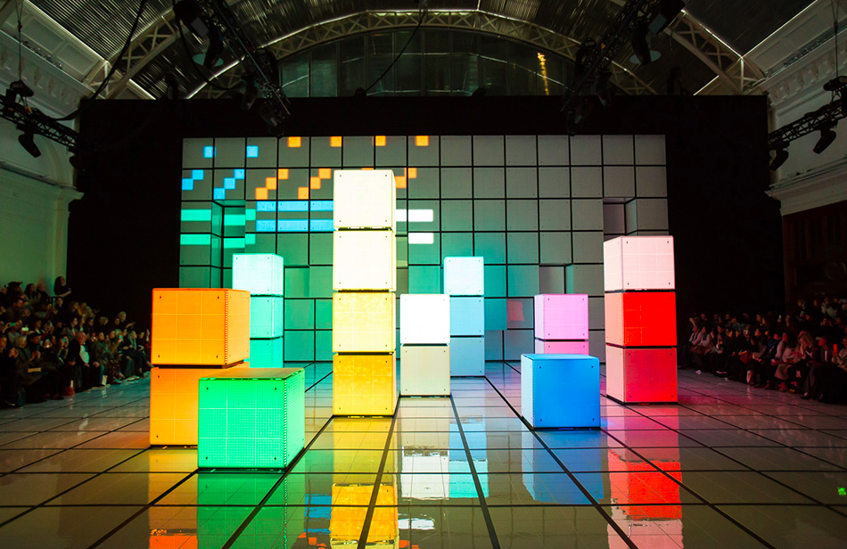
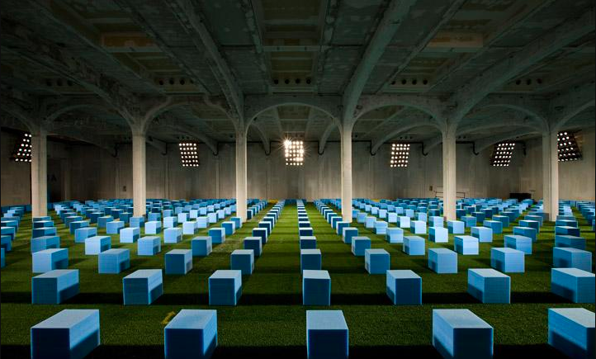
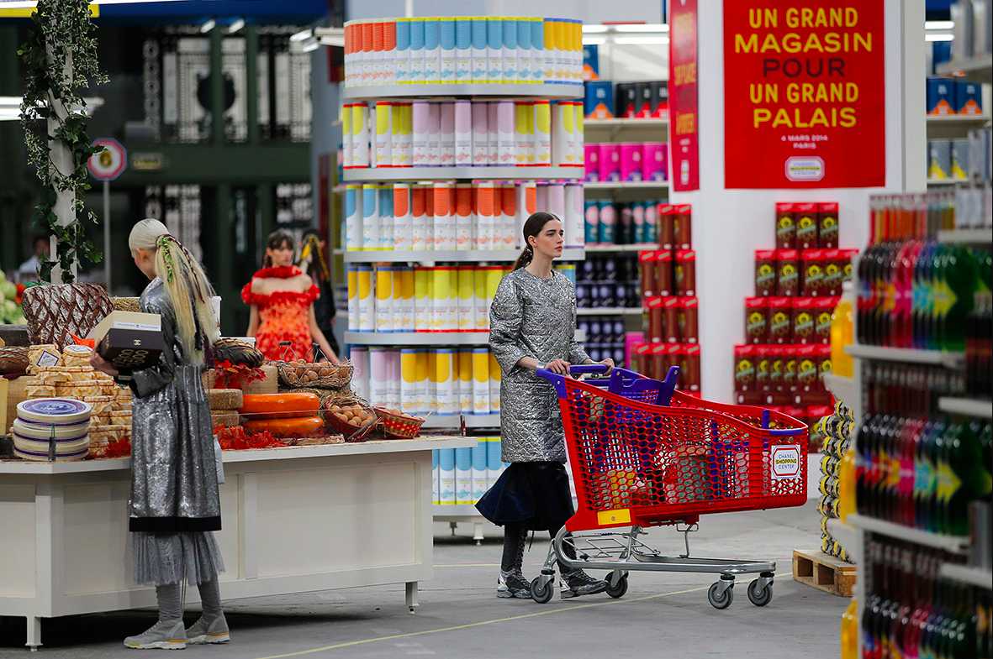
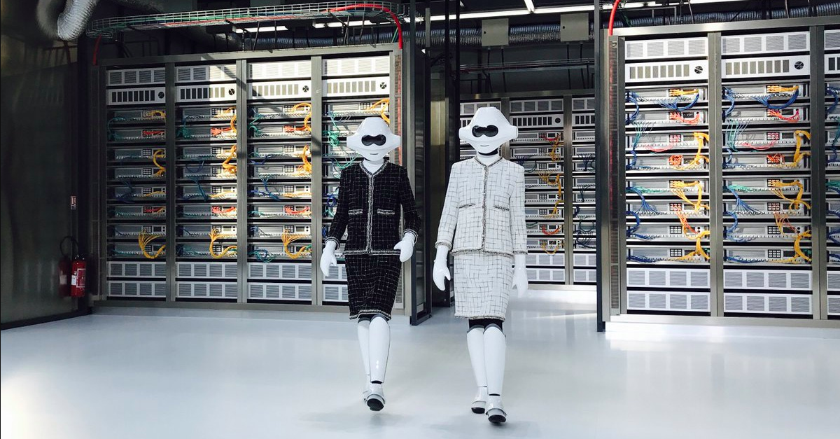
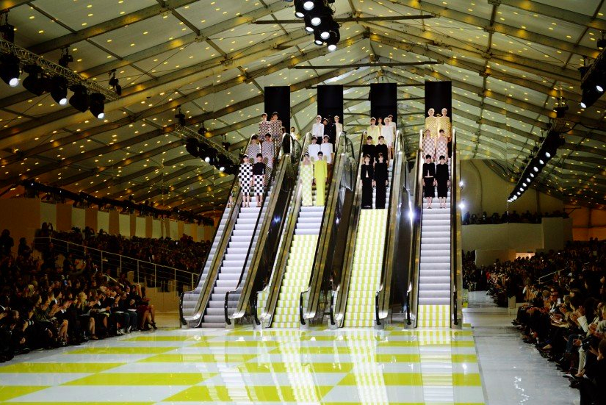
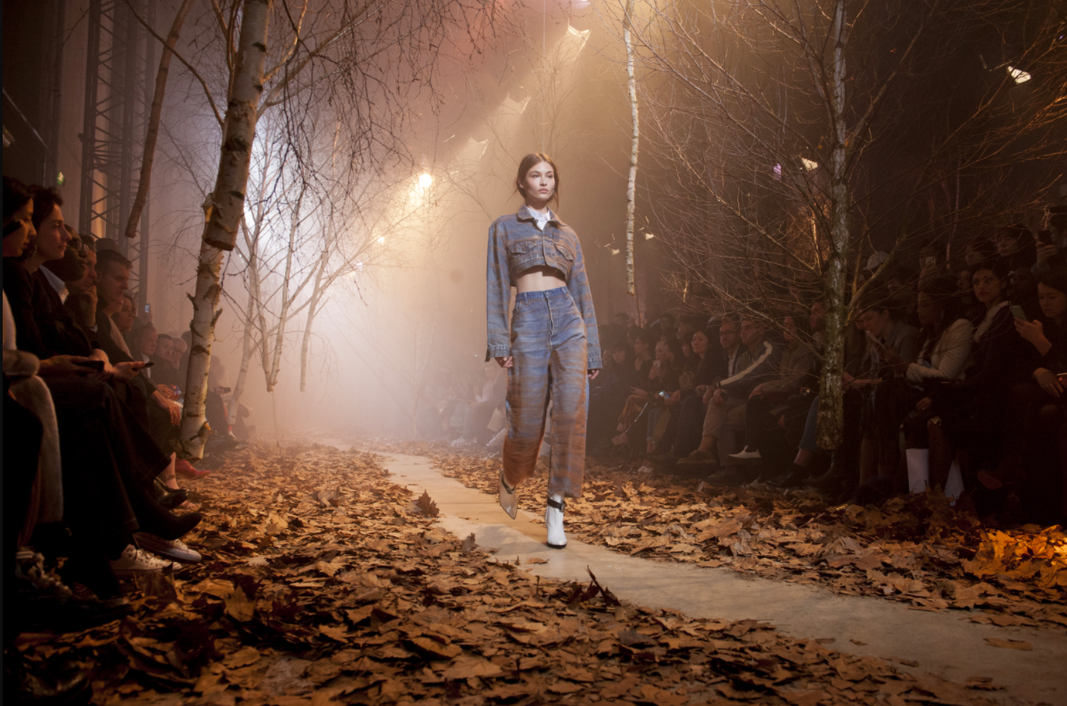
Theme 3 – five (5) examples

